Slide 1

What now?
Career services after career week
Notes:
Hello Ironhacker and welcome to this workshop on Understanding Emotions in the Bootcamp Journey and beyond. My name is Clara Pinillos, and I am excited to be here with all of you today. As we all know, learning to code, design, or prepare for a job interview can be an exciting, yet challenging journey.
In this workshop, we will explore the role of emotions in this journey and learn how to navigate them in a healthy and productive way.
By the end of this session, you will have a better understanding of what emotions are, how they impact your thoughts and behaviors, and practical tools to manage them effectively. So, let's dive in and explore this fascinating world.

Slide 2

You did this!

Slide 3
Now what? / Career Services
WHAT
Up to 1 year of services. Check our policies here.
Personalized service
Through 1-1’s & email correspondence
CV, LinkedIn & other document reviews (it can take up to 15 days to review them).
Employability & personal advice
NO TECH ADVICE
💡Our goal is to turn you into a job hunting expert

Slide 4
Before booking a 1:1, check out this Notion page

Slide 5
1-1’s with Career Advisor / Career Services
30 mins call via Zoom
Introduce your context
i.e. personal situation, job preferences, etc.
Job hunt strategy discussion.
Action Plan definition.
CV, Linkedin and other document review.

Slide 6
Now what? / Career Services
On site & online events
Find here networking events hosted by Ironhack.
Career Huddles are weekly meetings between a Career Coach and other Searching students from all bootcamps; Web Development, Data Analytics, UX/UI Design and Cybersecurity. Please register to access the sessions.
Partnership opportunities: you will receive them by email.
ES, PT, FR, GER, NL

Slide 7

How do I receive partnerships opportunities?

Slide 8
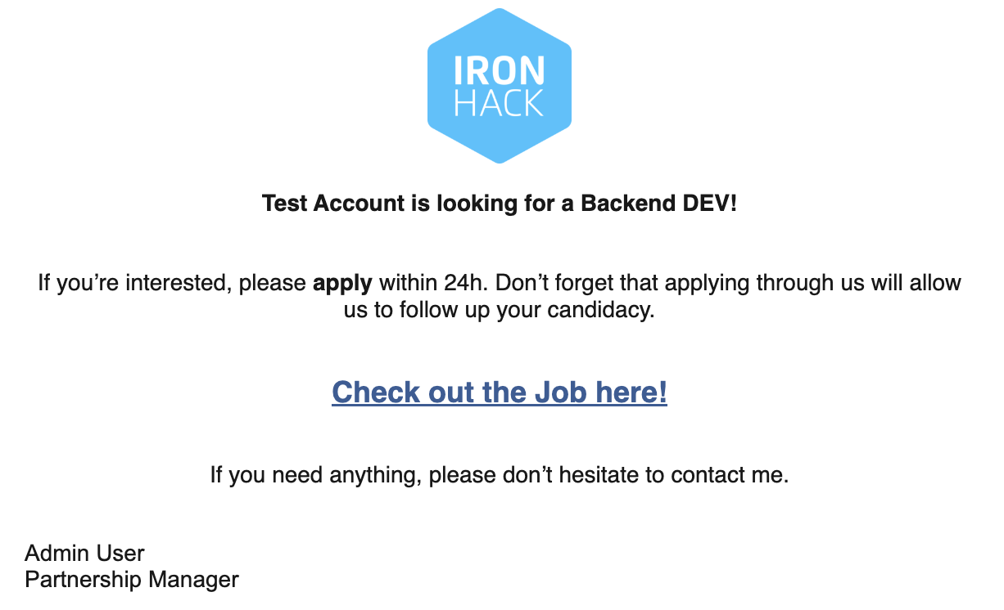

Slide 9

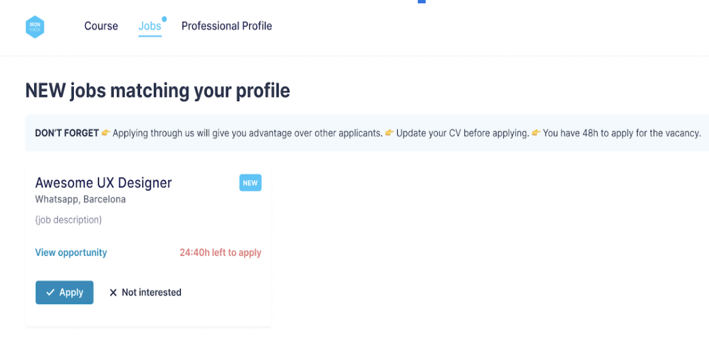
Click on the button “Check out the job here” to be redirected to the “Jobs Portal” and click on: Jobs
Once in the portal you can:
Learn more about the JV
Check out the time you have left to apply (limit 24h)
Scenario 1 Confirm your interest
Scenario 2: Reject the Job vacancy

Slide 10
Keep in mind…
💡Keep active in Huntr with your job applications (at least 5 per week).
🎯Reach us to your career advisor if you have any questions or need any help with your search. You will receive emails from us, and we would like you to keep us updated on your search so we can provide useful tips.
🌞If you haven’t done so already, send your request for CV & LinkedIn review or email us.
💙If you want us to check your cover letters and pitch, please request it via email.
⭐️ Take 2 minutes and update your job-searching status if needed.

Slide 11


